Slide 1

SSID: zenguest
Password: password
Notes:
Please remove this slide when sharing the document to the public

Slide 2


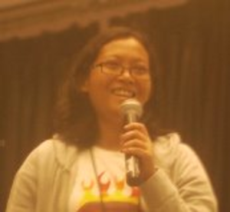





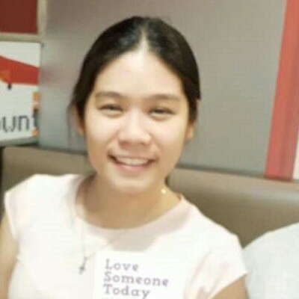




Artificial Intelligence Study Group
Twitter: @wwcodemanila
FB: fb.com/wwcodemanila
#WWCodeManila
#AI
#StudyGroup

Slide 3
Issa Tingzon
Research Fellow
PCARI
Notes:
Please use only the three colors for the content.

Slide 4
New Member’s Introduction

Slide 5

I am <name>
<your current profession>
<why did you join this study group?>
Notes:
Please use only the three colors for the content.

Slide 6



OUR MISSION
Inspiring women to excel in technology careers.

Slide 7

OUR VISION
A world where women are representative as technical executives, founders, VCs, board members and software engineers.

Slide 8
STUDY GROUP
Study groups are events where women can come together and help each other learn and understand a specific programming language, technology, or anything related to coding or engineering.

Slide 9
GUIDELINES
If you have a question, just ask
If you have an idea, share it
Make friends and learn from your study groupmates
Do not recruit or promote your business

Slide 10
AGENDA
Introduction to Probability for ML
Baye’s Theorem
Naïve Bayes Classifier

Slide 11
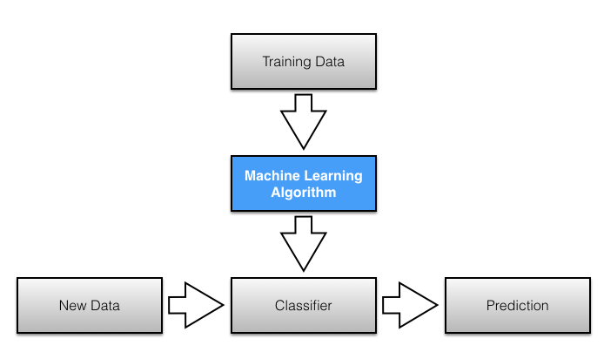

Slide 12


Slide 13
Probability for ML
REVIEW

Slide 14
Terminology
Probability – deals with measuring likelihood around events

Slide 15
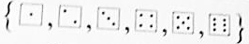
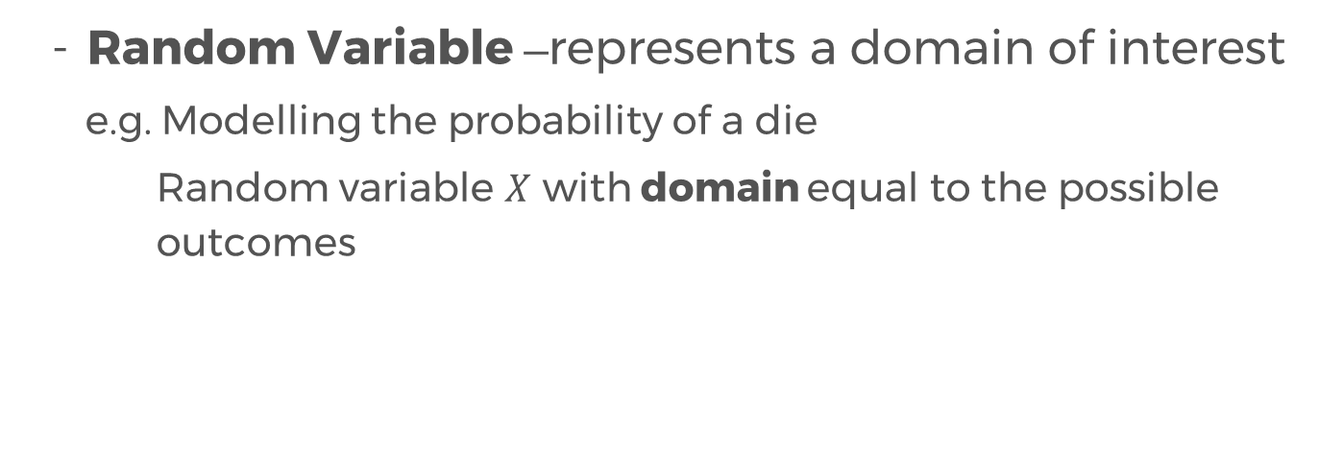
Terminology
Probability – deals with measuring likelihood around events
Random Variable –represents a domain of interest
e.g. Modelling the probability of a die
Random variable $X$ with domain equal to the possible outcomes

Slide 16
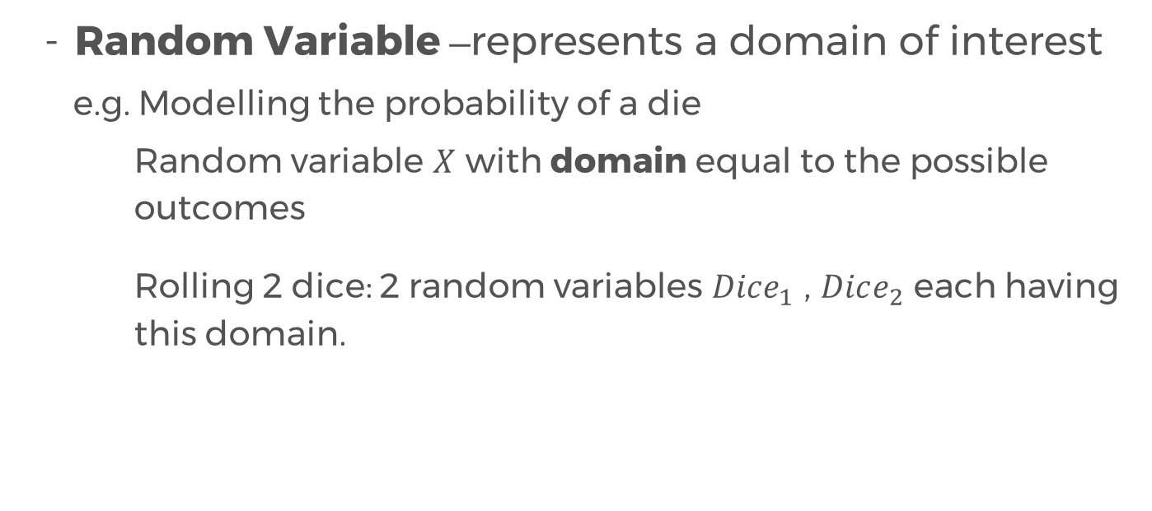
Terminology
Probability – deals with measuring likelihood around events
Random Variable –represents a domain of interest
e.g. Modelling the probability of a die
Random variable $X$ with domain equal to the possible outcomes
Rolling 2 dice: 2 random variables $Dice_{1}$ , $Dice_{2}$ each having this domain.

Slide 17
Terminology
Experiment – rolling the two dice

Slide 18
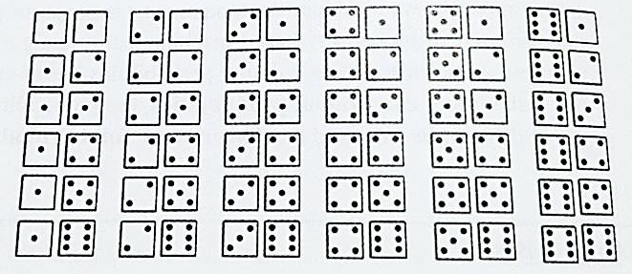
Terminology
Experiment – rolling the two dice
Sample Space – set of all possible outcomes of the experiment
Sample space for the domain of two dice

Slide 19
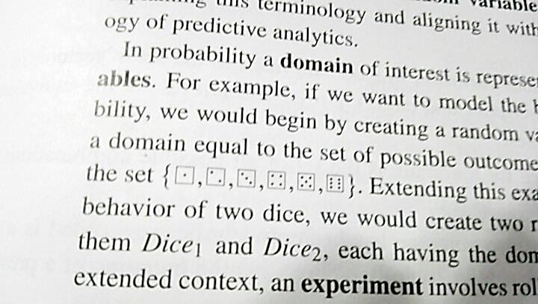
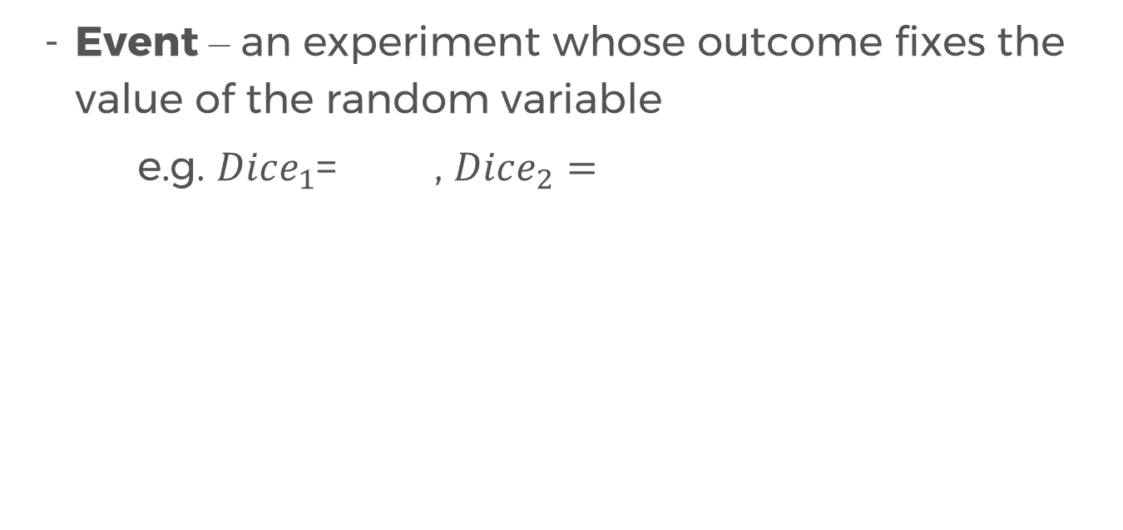
Terminology
Event – an experiment whose outcome fixes the value of the random variable
e.g. $Dice_{1}$= , $Dice_{2}=$

Slide 20
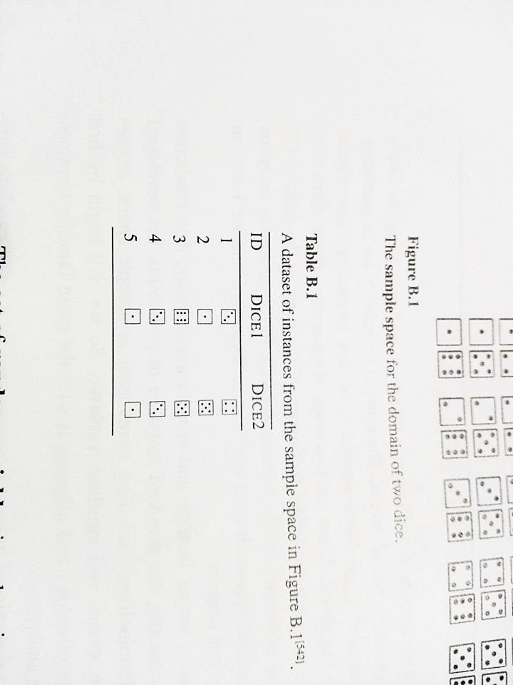
Terminology (Summary)
Set of random variables → set of features in dataset
Sample space → set of all combinations of assignments
Experiment whose outcome has been recorded → row in the dataset
Experiment whose outcome we do not know yet → prediction task
Event → any subset of an experiment
e.g. ($Dice_{1}$= ) , ($Dice_{1}\text{=} , Dice_{2}=$ )

Slide 21
Terminology (Summary)
Set of random variables → set of features in dataset
Sample space → set of all combinations of assignments
Experiment whose outcome has been recorded → row in the dataset
Experiment whose outcome we do not know yet → prediction task
Event → any subset of an experiment
e.g. ($Dice_{1}$= ) , ($Dice_{1}\text{=} , Dice_{2}=$ )

Slide 22
Terminology (Summary)
Set of random variables → set of features in dataset
Sample space → set of all combinations of assignments
Experiment whose outcome has been recorded → row in the dataset
Experiment whose outcome we do not know yet → prediction task
Event → any subset of an experiment
e.g. ($Dice_{1}$= ) , ($Dice_{1}\text{=} , Dice_{2}=$ )

Slide 23
Terminology (Summary)
Set of random variables → set of features in dataset
Sample space → set of all combinations of assignments
Experiment whose outcome has been recorded → row in the dataset
Experiment whose outcome we do not know yet → prediction task
Event → any subset of an experiment
e.g. ($Dice_{1}$= ) , ($Dice_{1}\text{=} , Dice_{2}=$ )

Slide 24
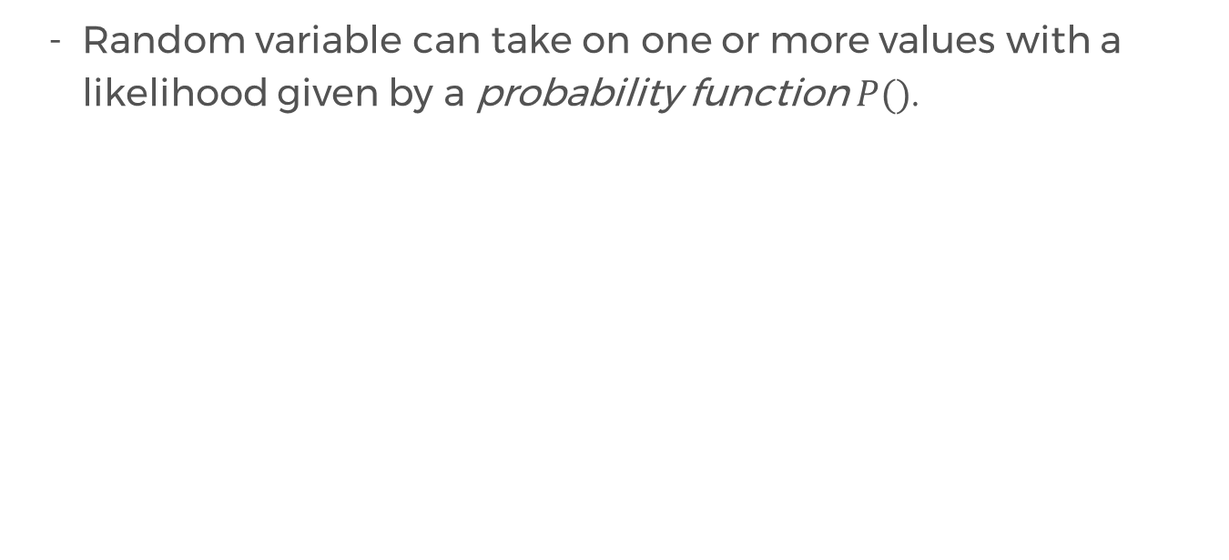
Probability Functions
Random variable can take on one or more values with a likelihood given by a probability function $P()$.

Slide 25
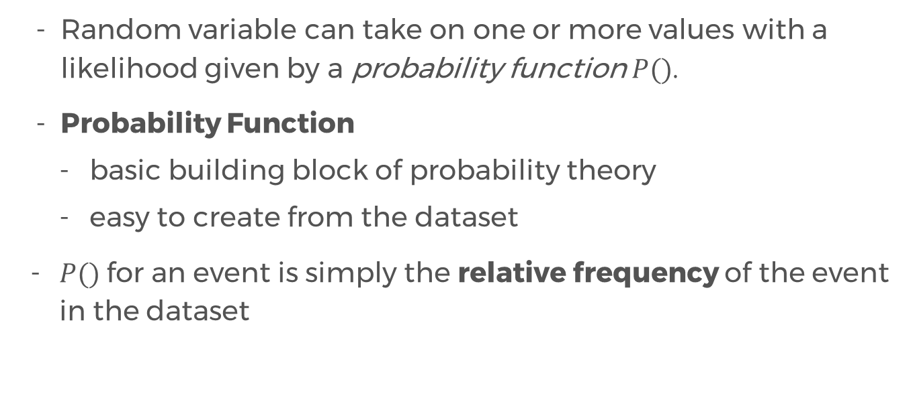
Probability Functions
Random variable can take on one or more values with a likelihood given by a probability function $P()$.
Probability Function
basic building block of probability theory
easy to create from the dataset
$P()$for an event is simply the relative frequency of the event in the dataset

Slide 26
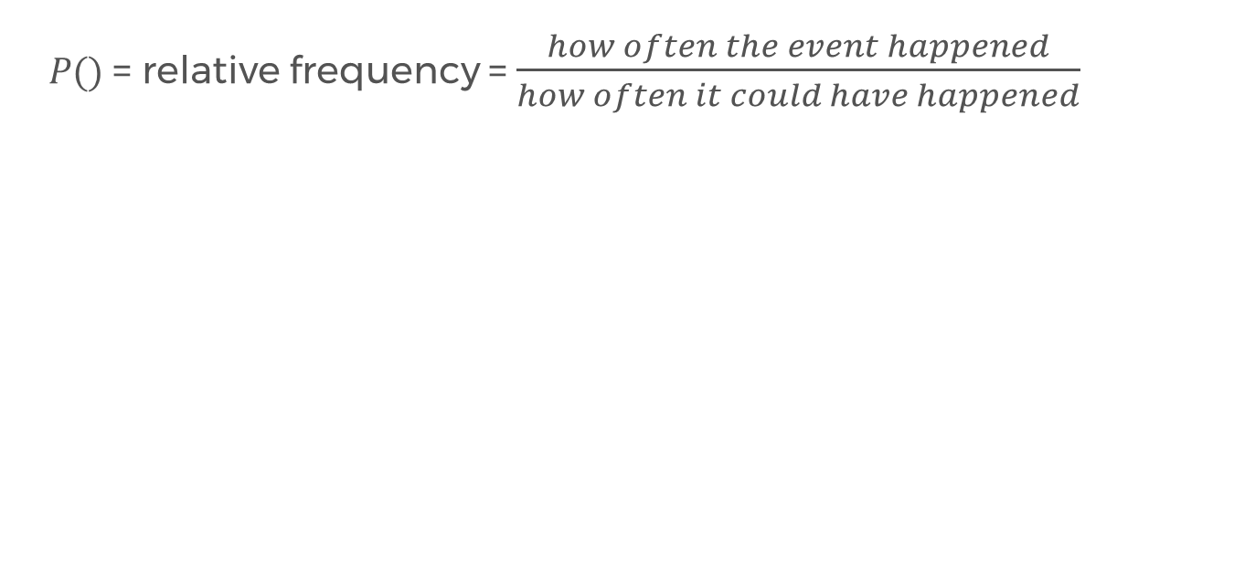
Probability Functions
$P()$= relative frequency = $\frac{how often the event happened}{how often it could have happened}$

Slide 27
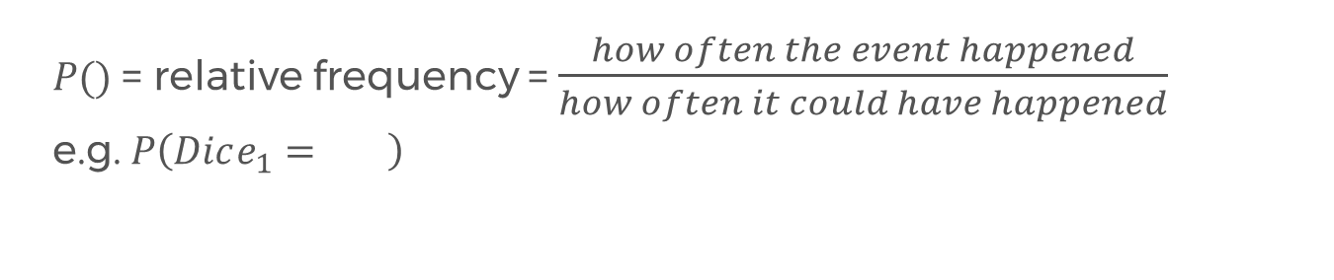
Probability Functions
$P()$= relative frequency = $\frac{how often the event happened}{how often it could have happened}$
e.g. $P\left(Dice_{1}= \right)$

Slide 28
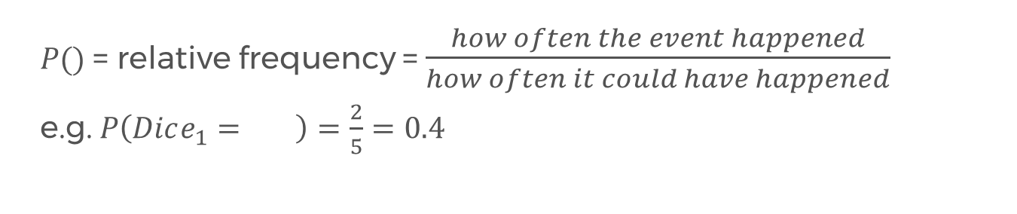
Probability Functions
$P()$= relative frequency = $\frac{how often the event happened}{how often it could have happened}$
e.g. $P\left(Dice_{1}= \right)=\frac{2}{5}=0.4$

Slide 29
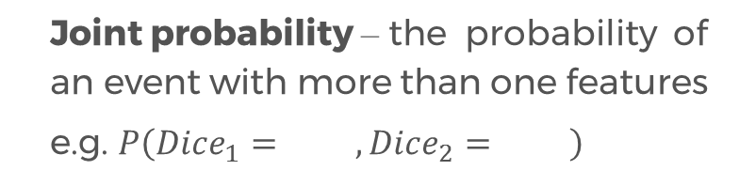
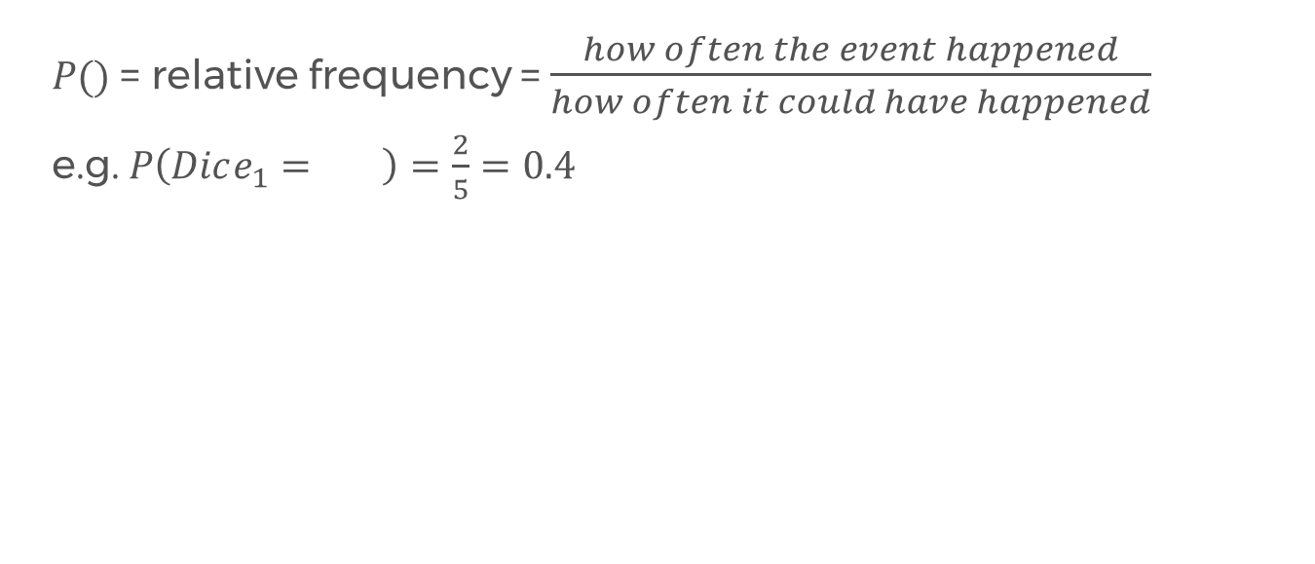
Probability Functions
$P()$= relative frequency = $\frac{how often the event happened}{how often it could have happened}$
e.g. $P\left(Dice_{1}= \right)=\frac{2}{5}=0.4$
Joint probability – the probability of an event with more than one features
e.g. $P\left(Dice_{1}= , Dice_{2}= \right)$

Slide 30
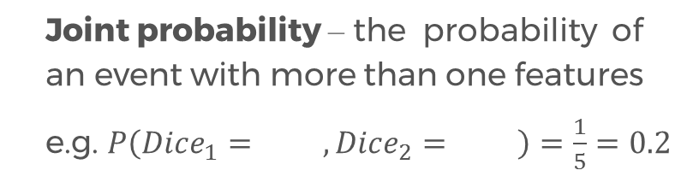
Probability Functions
$P()$= relative frequency = $\frac{how often the event happened}{how often it could have happened}$
e.g. $P\left(Dice_{1}= \right)=\frac{2}{5}=0.4$
Joint probability – the probability of an event with more than one features
e.g. $P\left(Dice_{1}= , Dice_{2}= \right)=\frac{1}{5}=0.2$

Slide 31
Conditional and Unconditional Probabilities
The types of probabilities we’ve calculated so far are known as prior probabilities or unconditional probabilities.

Slide 32
Conditional and Unconditional Probabilities
The types of probabilities we’ve calculated so far are known as prior probabilities or unconditional probabilities.
What about the probability of an event where one or more events are known to have happened?

Slide 33
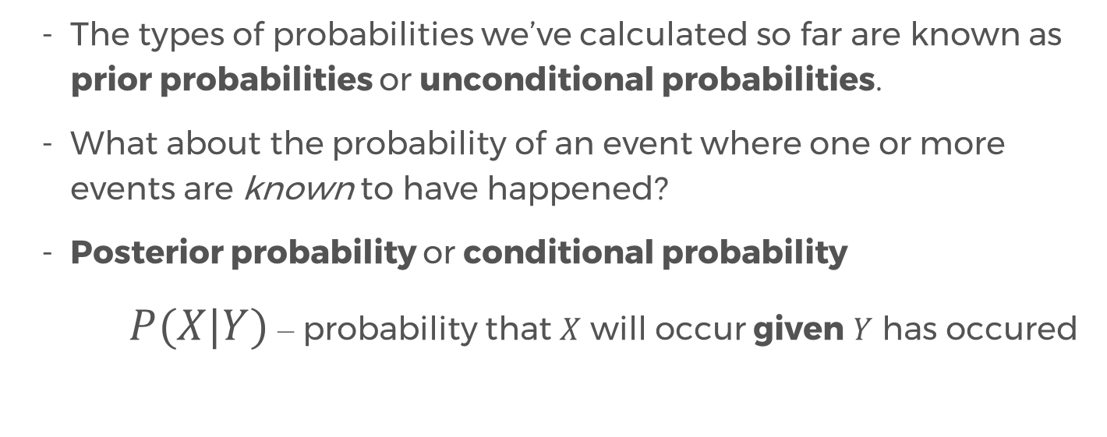
Conditional and Unconditional Probabilities
The types of probabilities we’ve calculated so far are known as prior probabilities or unconditional probabilities.
What about the probability of an event where one or more events are known to have happened?
Posterior probability or conditional probability
$P(X|Y)$ – probability that $X$ will occur given $Y$ has occured
read as “given”

Slide 34
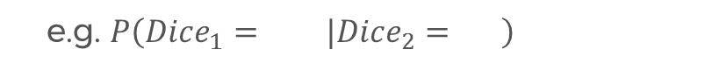
Aposteriori (conditional) Probability
e.g. $P\left(Dice_{1}= |Dice_{2}= \right)$

Slide 35
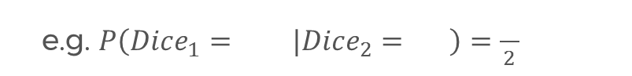
Aposteriori (conditional) Probability
e.g. $P\left(Dice_{1}= |Dice_{2}= \right)=\frac{}{2}$

Slide 36
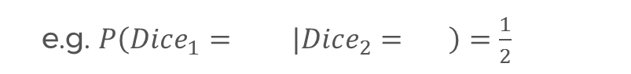
Aposteriori (conditional) Probability
e.g. $P\left(Dice_{1}= |Dice_{2}= \right)=\frac{1}{2}$

Slide 37
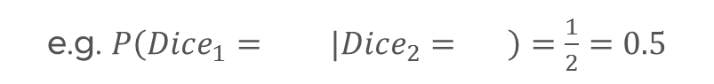
Aposteriori (conditional) Probability
e.g. $P\left(Dice_{1}= |Dice_{2}= \right)=\frac{1}{2}=0.5$

Slide 38
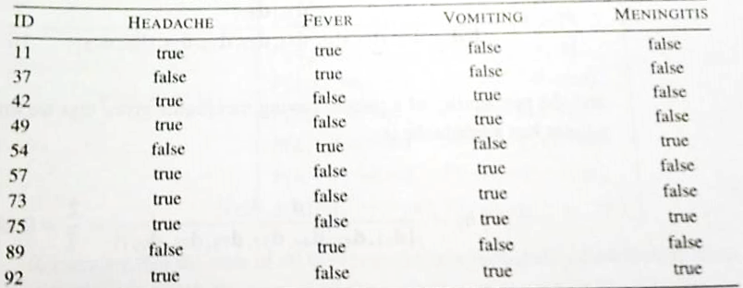
Quick Exercise 1
$P\left(H=true\right) 2. P\left(H=true, M=true\right) 3. P(M=true|H=true)$

Slide 39
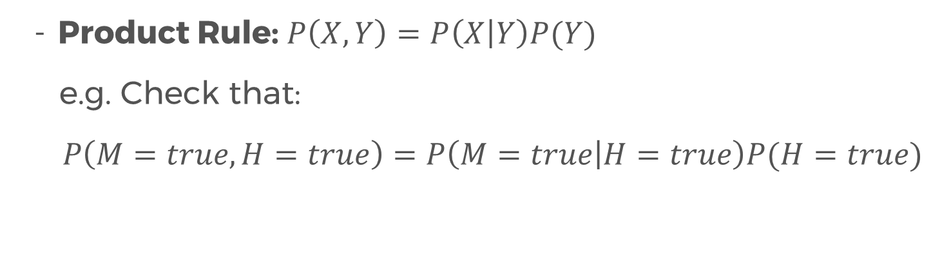
Useful Property
Product Rule: $P\left(X,Y\right)=P\left(X | Y\right)P(Y)$
e.g. Check that:
$$P\left(M=true, H=true\right)=P\left(M=true | H=true\right)P(H=true)$$

Slide 40
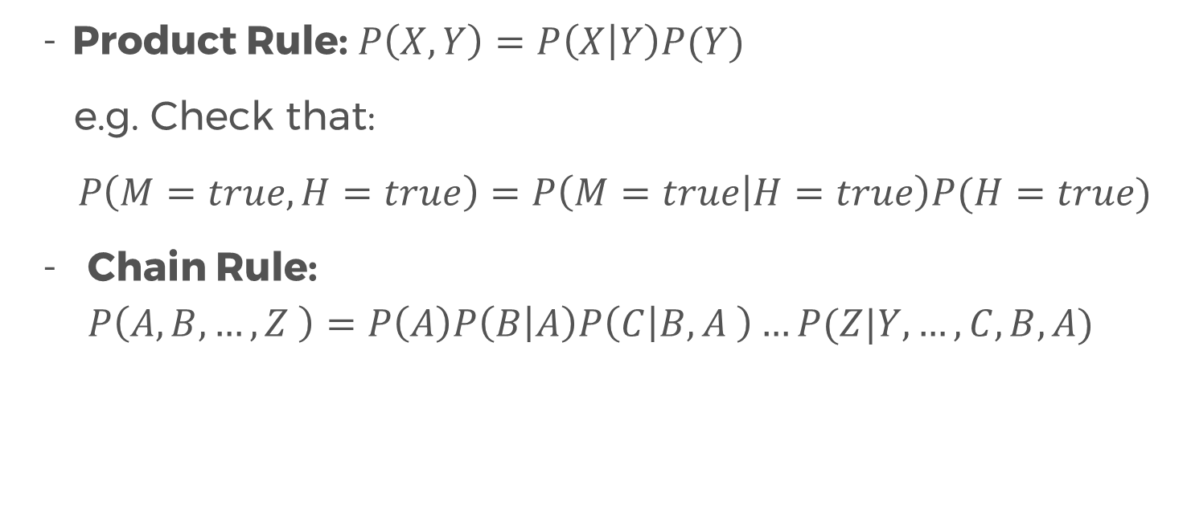
Useful Property
Product Rule: $P\left(X,Y\right)=P\left(X | Y\right)P(Y)$
e.g. Check that:
$$P\left(M=true, H=true\right)=P\left(M=true | H=true\right)P(H=true)$$
Chain Rule: $P\left(A,B,…,Z \right)=P\left(A\right)P\left(B | A\right)P\left(C | B,A \right)…P(Z|Y,…,C,B,A)$

Slide 41

Bayes’ Theorem
$$P\left(Y | X\right)=\frac{P\left(X | Y\right)P(Y)}{P(X)}$$
- Proving this is pretty simple.

Slide 42
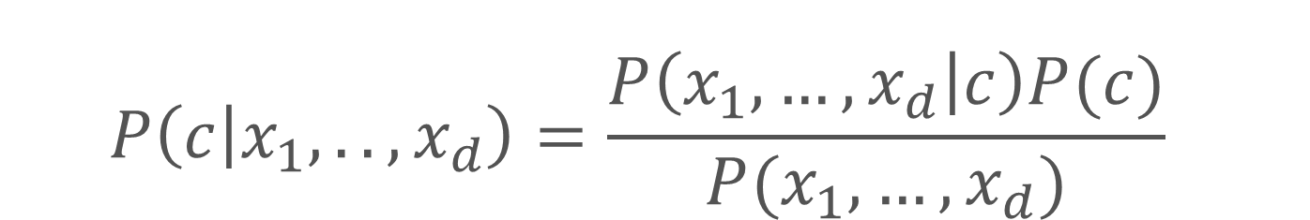
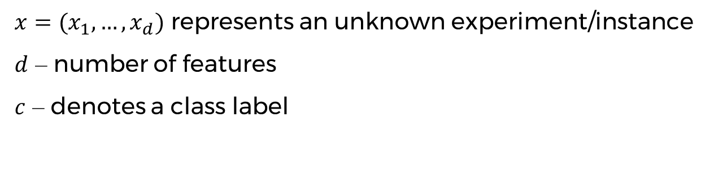
Bayesian Prediction
$$P\left(c | x_{1},..,x_{d}\right)=\frac{P\left(x_{1},…,x_{d} | c\right)P(c)}{P(x_{1},…,x_{d})}$$
$x=(x_{1},…,x_{d})$ represents an unknown experiment/instance
$d$ – number of features
$c$ – denotes a class label

Slide 43
Example
A patient comes in with a headache, vomiting, but no fever.
What is the probability that the patient has meningitis given these conditions?

Slide 44
Exercise 3
A patient comes in with a headache, vomiting, but no fever.
What is the probability that the patient does not have meningitis given these conditions?

Slide 45

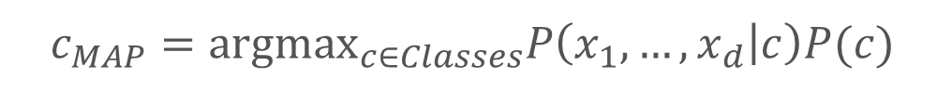
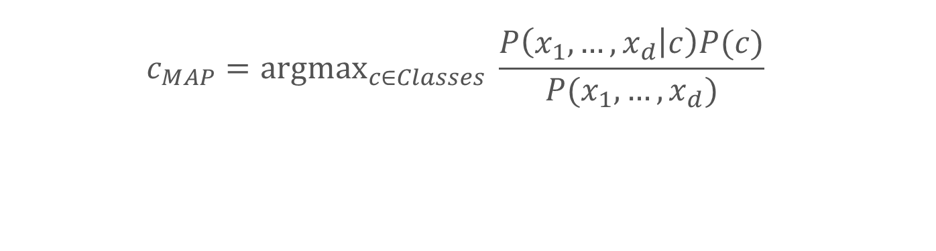
Maximum Aposteriori Prediction (MAP)
$$c_{MAP}={argmax}_{c∈Classes} P\left(c | x_{1},..,x_{d}\right)$$
$$c_{MAP}={argmax}_{c∈Classes} \frac{P\left(x_{1},…,x_{d} | c\right)P(c)}{P(x_{1},…,x_{d})}$$
$$c_{MAP}={argmax}_{c∈Classes}P\left(x_{1},…,x_{d} | c\right)P(c)$$
Basically, this tells us the class label that returns the highest probability!

Slide 46
Maximum Aposteriori Prediction (MAP)
$$c_{MAP}={argmax}_{c∈Classes} P\left(c | x_{1},..,x_{d}\right)$$
$$c_{MAP}={argmax}_{c∈Classes} \frac{P\left(x_{1},…,x_{d} | c\right)P(c)}{P(x_{1},…,x_{d})}$$
$$c_{MAP}={argmax}_{c∈Classes}P\left(x_{1},…,x_{d} | c\right)P(c)$$
Basically, this tells us the class label that returns the highest probability!
For the patient with headache, vomiting, but no fever, what will be his predicted diagnosis in terms of meningitis?

Slide 47
Exercise 4
A patient comes in with a headache, a fever, and vomiting.
What is the probability that the patient has meningitis given these conditions?

Slide 48
The Problem with Bayesian Prediction
The problem is that our dataset is not large enough to be representative of the headache-fever-vomiting meningitis diagnosis scenario

Slide 49
The Problem with Bayesian Prediction
The problem is that our dataset is not large enough to be representative of the headache-fever-vomiting meningitis diagnosis scenario
In practice, it is impossible to collect a dataset that is big enough to cover all possible combinations.

Slide 50
The Problem with Bayesian Prediction
The problem is that our dataset is not large enough to be representative of the headache-fever-vomiting meningitis diagnosis scenario
In practice, it is impossible to collect a dataset that is big enough to cover all possible combinations.
Conditional independence can help overcome these flaws.

Slide 51
Independence
Two events are independent if one event has no effect on another event, ad vice-versa
e.g. singing karaoke all night, and the event of rain in the morning

Slide 52
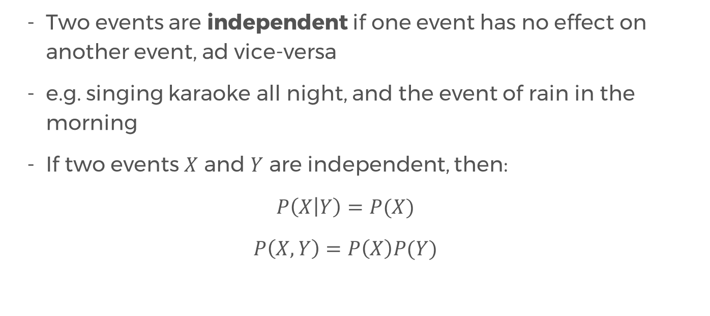
Independence
Two events are independent if one event has no effect on another event, ad vice-versa
e.g. singing karaoke all night, and the event of rain in the morning
If two events $X$ and $Y$ are independent, then:
$$P\left(X | Y\right)=P(X)$$
$$P\left(X,Y\right)=P\left(X\right)P(Y)$$

Slide 53
Conditional Independence
Full independence is quite rare
More common: two or more events may be independent if we know that a third event has happened
This is called Conditional Independence

Slide 54
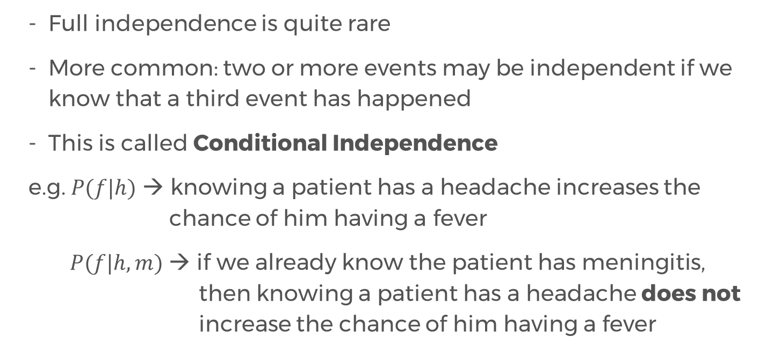
Conditional Independence
Full independence is quite rare
More common: two or more events may be independent if we know that a third event has happened
This is called Conditional Independence
e.g. $P(f|h)$ → knowing a patient has a headache increases the chance of him having a fever
$P(f|h,m)$ → if we already know the patient has meningitis, then knowing a patient has a headache does not increase the chance of him having a fever

Slide 55
Conditional Independence
The information we get from knowing the patient has a headache is contained within the information that the patient has meningitis

Slide 56
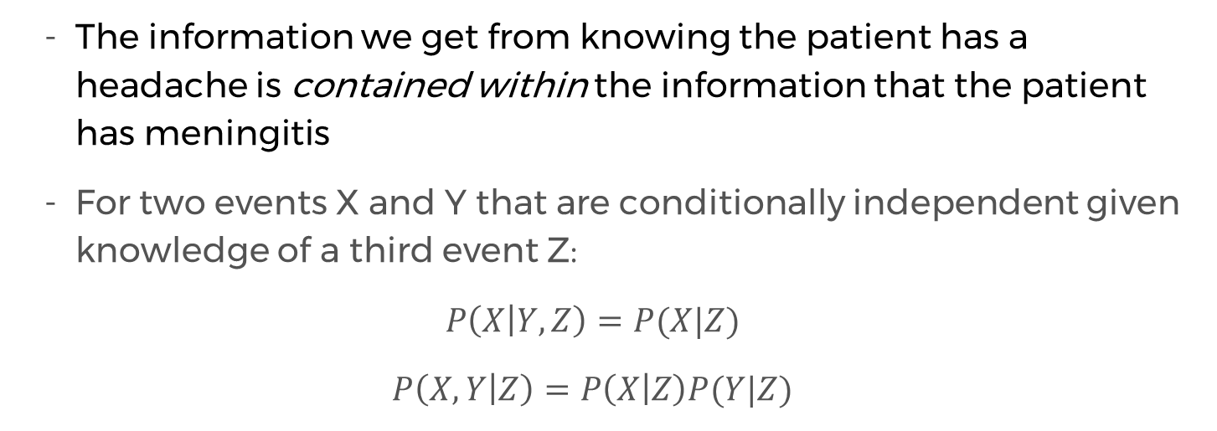
Conditional Independence
The information we get from knowing the patient has a headache is contained within the information that the patient has meningitis
For two events X and Y that are conditionally independent given knowledge of a third event Z:
$$P\left(X | Y,Z\right)=P(X|Z)$$
$$P\left(X,Y | Z\right)=P\left(X | Z\right)P(Y|Z)$$

Slide 57
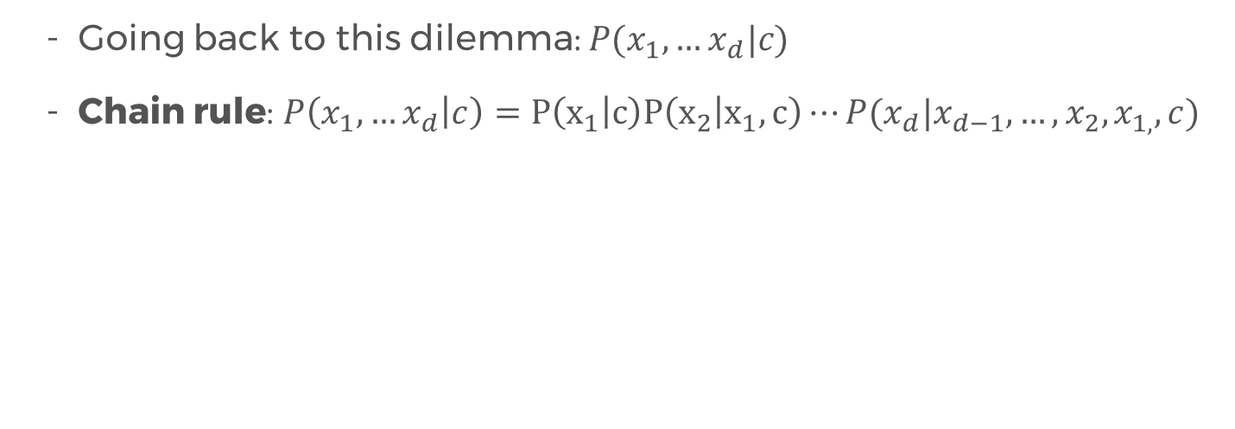
Conditional Independence
Going back to this dilemma: $P(x_{1},…x_{d}|c)$
Chain rule: $P\left(x_{1},…x_{d} | c\right)=P\left(x_{1} | c\right)P\left(x_{2} | x_{1},c\right)⋯P(x_{d}|x_{d−1},…,x_{2},x_{1,},c)$

Slide 58
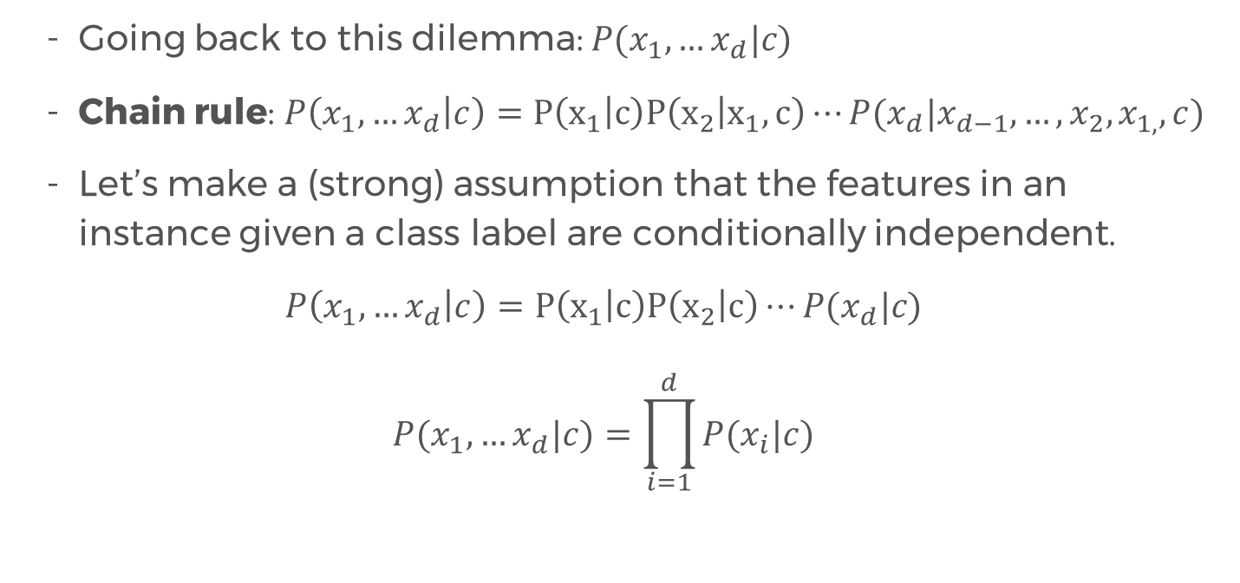
Conditional Independence
Going back to this dilemma: $P(x_{1},…x_{d}|c)$
Chain rule: $P\left(x_{1},…x_{d} | c\right)=P\left(x_{1} | c\right)P\left(x_{2} | x_{1},c\right)⋯P(x_{d}|x_{d−1},…,x_{2},x_{1,},c)$
Let’s make a (strong) assumption that the features in an instance given a class label are conditionally independent.
$$P\left(x_{1},…x_{d} | c\right)=P\left(x_{1} | c\right)P\left(x_{2} | c\right)⋯P(x_{d}|c)$$
$$P(x_{1},…x_{d}|c)=\prod_{i=1}^{d}{P(x_{i}|c)}$$

Slide 59
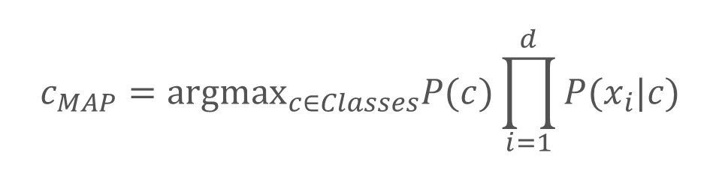
Naïve Bayes Classifier
Returns a MAP prediction, where the posterior (conditional) probabilities are computed under the strong assumption of conditional independence between features given the class label.
$$c_{MAP}={argmax}_{c∈Classes}P(c)\prod_{i=1}^{d}{P(x_{i}|c)}$$

Slide 60
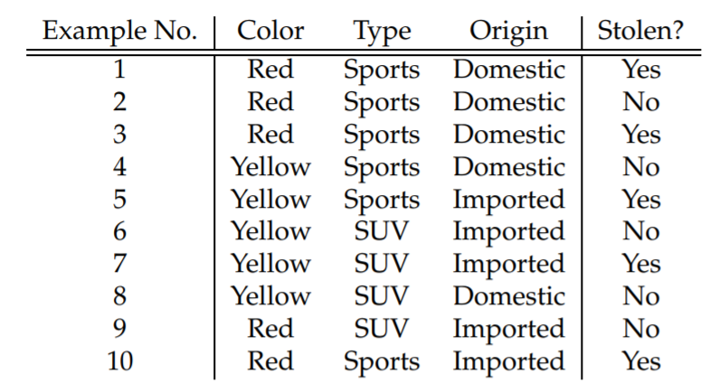
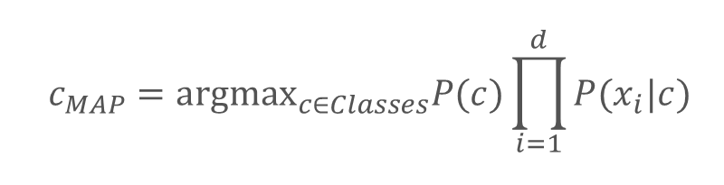
Naïve Bayes Classifier
$$c_{MAP}={argmax}_{c∈Classes}P(c)\prod_{i=1}^{d}{P(x_{i}|c)}$$
Will a Red domestic SUV be likely to be stolen or not?

Slide 61
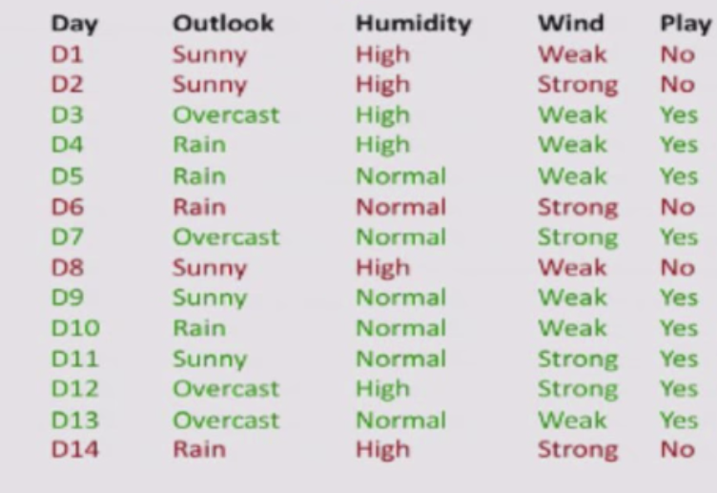
EXERCISE
G
Count the statistics.
Will John play tennis if the outlook is sunny, humidity is high, and wind is strong?
What about when it’s rainy, highly humid, and not windy?

Slide 62
References
Decision Tree Lecture by Victor Lavrenko (Youtube)
Random Forests Video by Siraj Raval
Notes:
Please use only the three colors for the content.

Slide 63
T.I.L.
SHARE IT!
In front!
On Twitter: @wwcodemanila
Or FB: fb.com/wwcodemanila
Don’t forget to tag WWCodeManila so we can retweet or share it.
Notes:
Please use only the three colors for the content.

Slide 64
Feedback Form
https://goo.gl/YzSqcS
Please don’t rate the event on meetup.
Not helpful. It is best to just tell your concerns via the feedback form. We are a building a community not a Yelp restaurant.
Notes:
Please use only the three colors for the content.

Slide 65
THANK YOU :)
Notes:
Please use only the three colors for the content.

